Slide 1
System and Network Administration
Assignment &
Field of Study

Slide 2

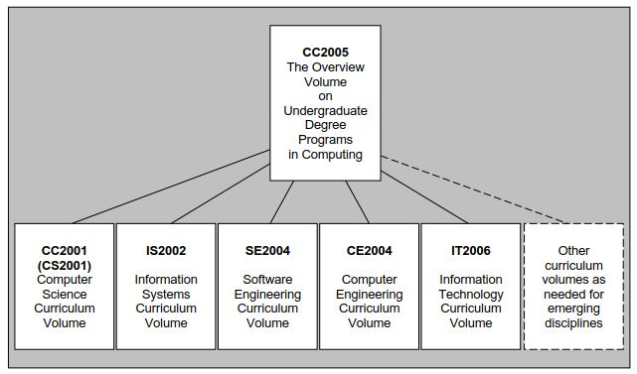

Slide 3
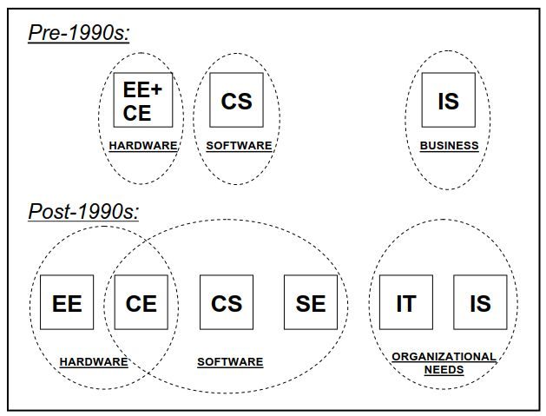

Slide 4
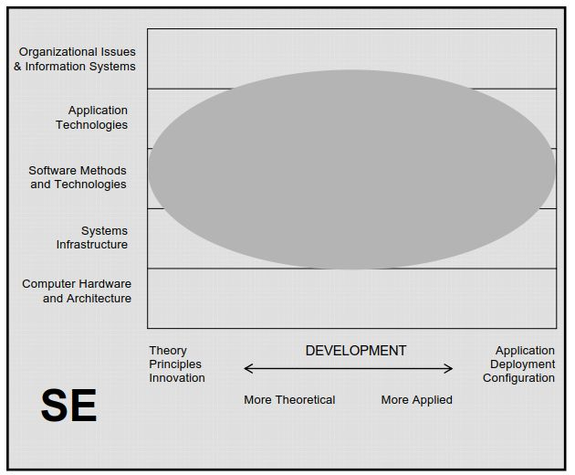

Slide 5
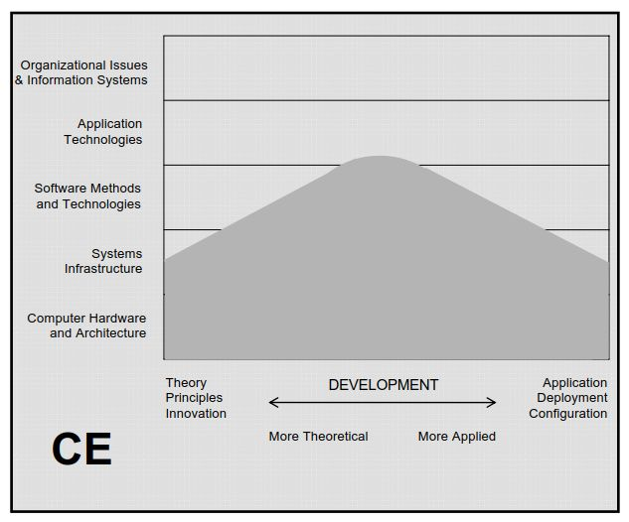
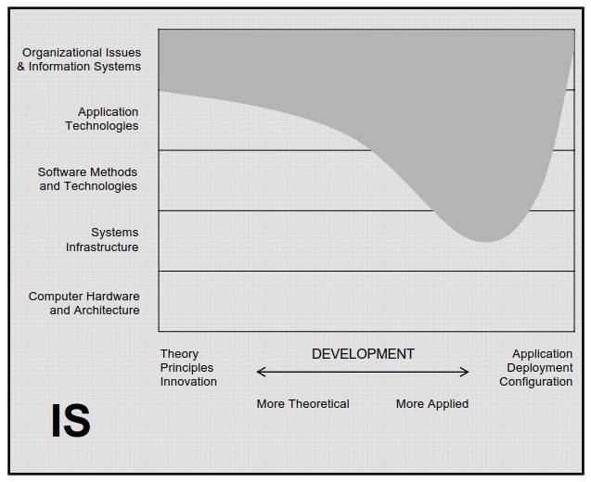

Slide 6
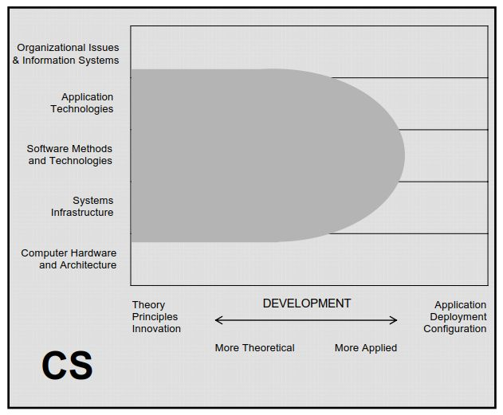
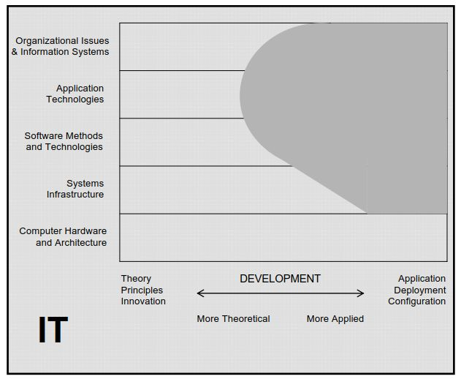

Slide 7
MQA Learning Outcomes
The learning outcomes for programmes are specified by the Malaysian Qualifications Agency in the Programme Standards: Computing (2015) http://www.mqa.gov.my.
There are specific learning outcomes for the four (4) disciplines identified in the Programme Standards, the most important of which are:

Slide 8
MQA Learning Outcomes
Computer Science
Upon completion of the programme, graduates should be able to:
analyze algorithms as well as design and optimize computational solutions; and
apply computing skills in analyzing, modelling, designing, developing, programming and evaluating efficient computing solutions.

Slide 9
MQA Learning Outcomes
Information Technology
Upon completion of the programme, graduates should be able to:
design, implement and manage Information technology solutions and resources, and
recognise the impact of technology on individuals, organisation and society.

Slide 10
MQA Learning Outcomes
Software Engineering
Upon completion of the programme, graduates should be able to:
apply appropriate methodologies, models and techniques that provide a basis for analysis, design, development, test and implementation, evaluation, maintenance, and documentation of a large scale software.

Slide 11
MQA Learning Outcomes
Information Systems
Upon completion of the programme, graduates should be able to:
demonstrate understanding of business requirement; and
be able to plan, design and manage business Information Systems, with the relevant technology and knowledge to enhance organisational performance.

Slide 12




